Slide 1
Soil, Water and Air Spring Issues Forum
U.S Department of the Interior
Bureau of Land Management
Oil and Gas Development:
Best Management Practices Databases
May 12, 2015
Kathryn Mutz
Natural Resources LLC for the Getches-Wilkinson Center for Natural Resources, Energy and the Environment
University of Colorado Law School

Slide 2
Resources
Intermountain Oil & Gas Best Management Practices Project
http://www.oilandgasbmps.org
LawAtlas Database
http://lawatlas.org/oilandgas

Slide 3
BMP Definitions
Bureau of Land Management / BMP Project
State-of-the-art mitigation measures applied to oil and natural gas drilling and production to help ensure that energy development is conducted in an environmentally responsible manner.
http://www.blm.gov/wo/st/en/prog/energy/oil_and_gas/ best_management_practices.html
ble manner.”
Notes:
Expansive definition – voluntary practices of industry to laws and regulations
Appreciate the help that BLM has given to this project over many years – esp. Jim Perry.

Slide 4
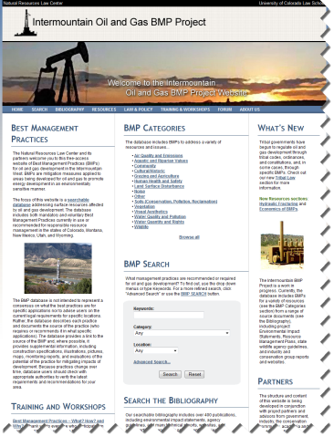
Intermountain Oil & Gas BMP Project
Geographic Scope
CO, MT, NM, UT, WY
Beyond the Region
Databases
BMPs
Bibliography
Laws and Regulations (LawAtlas)
Website Background Materials
Resource Pages
Law and Policy
(Federal, state, local, tribes)
Research Services
Workshops

Slide 5
BMP Database
Over 8,500 BMPs
Air Quality
Aquatic/Riparian
Community
Cultural/Historic
Grazing/Agriculture
Human Health/Safety
Land Surface Disturbance
Noise
Soils
Vegetation
Visual
Water Quality/Quantity
Wildlife
BMP Database
Create a free, online database documenting BMPs for responsible oil and gas development in the Intermountain West
Wide audience, including industry, communities, government, and environmental advocates
What is “the Best”?
Effectiveness
Cost/benefit analysis

Slide 9
Bibliographic Database
Over 800 Citations
Searchable on author, title, and annotation
Authors include:
Government agencies
Advocacy groups
Industry
Academics
Publications include:
EISs
Research reports, factsheets
Media articles
Books, Journals, PPTs
Websites
Bibliographic Database
Source documents for BMPs
Supplemental documents for Resource and Law & Policy pages
Web link and .pdf file

Slide 15
LawAtlas Database
2015 Expansion
Adding states
Adding Federal
BLM
EPA
Local Jurisdictions
Tribal Codes?
Model Laws
Additional Issues:
Setbacks
Noise abatement
Induced Seismicity
Comparative analysis
Comparative Law Database
Water Quality – Lifecycle of field development
Water Quantity – Administration, reporting, conservation, etc.
Air Quality – Flares, engines, leak detection, storage, etc.

Slide 16
LawAtlas: www.lawatlas.org
Colorado – Piceance, Niobrara
Montana – Bakken
New Mexico – San Juan, Permian
Wyoming – Greater Green River, Powder River Basin
Utah – Mancos, Uinta
Louisiana – Haynesville
New York – Marcellus
North Dakota – Bakken
Ohio – Marcellus
Oklahoma – Woodford
Pennsylvania – Marcellus
Texas – Eagle Ford, Barnett
West Virginia – Marcellus
Current
BLM – Federal and Indian lands
EPA -- CAA, CWA, SDWA
California – Monterrey
Illinois – New Albany
Arkansas – Fayetteville
Local jurisdictions
Next

Slide 17
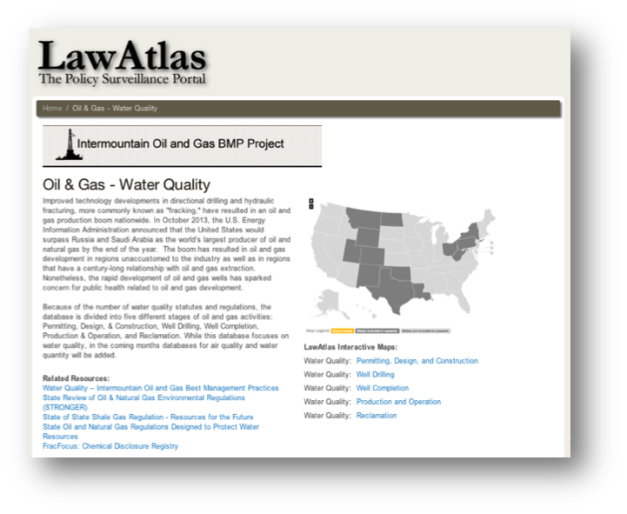
Comparative Law Database

Slide 19
Database Expansion
Project Plan:
BMP Database expansion
By topic; by publication
Evaluation of BMPs
Effectiveness
Cost/Benefit
Bibliographic database additions
Law Atlas additions – topics beyond water and air
Resource and Law & Policy pages
Expand outreach

Slide 20
Project Contacts
For more information
Browse the websites at:
www.oilandgasbmps.org and www.lawatlas.org/oilandgas
Contact Kathryn Mutz
kathryn.Mutz@colorado.edu;
303-499-1092
for questions related to the BMP project.
Contact Matt Samelson
matthewsamelson@gmail.com
303-519-5769
for questions related to the LawAtlas database.
Contact Kelleigh Helm
kelleigh.helm@colorado.edu
303-492-1293
for questions related to the GWC energy program.

