Slide 1

Potential Public Health Implications of Oil and Gas Air Pollutants
December 7, 2017
Managing Oil and Gas for Local Priorities: MOUs and Regulatory Options
Lisa M. McKenzie

Slide 2
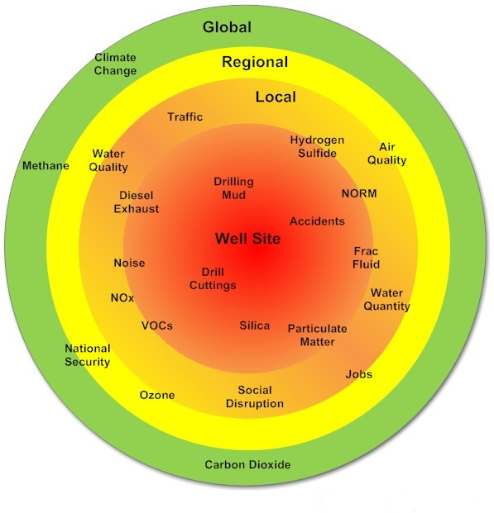
Scale of Exposure (Adgate et. al. 2014)

Slide 3
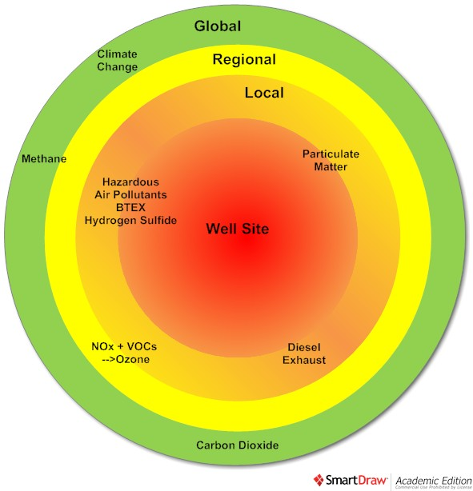
Air Emissions

Slide 4

Time Series Benzene PTR-MS Measurements,
Platteville, 7/17/14-8/8/14; Halliday et. al. 2016
ATSDR Sub-chronic MRL
ATSDR Acute MRL
Notes:
Halliday, H. S.; Thompson, A. M.; Wisthaler, A.; Blake, D.; Hornbrook, R. S.; Mikoviny, T.; Müller, M.; Eichler, P.; Apel, E. C.; Hills, A. J., Atmospheric benzene observations from oil and gas production in the Denver Julesburg basin in July and August 2014. Journal of Geophysical Research: Atmospheres 2016, n/a-n/a.

Slide 5
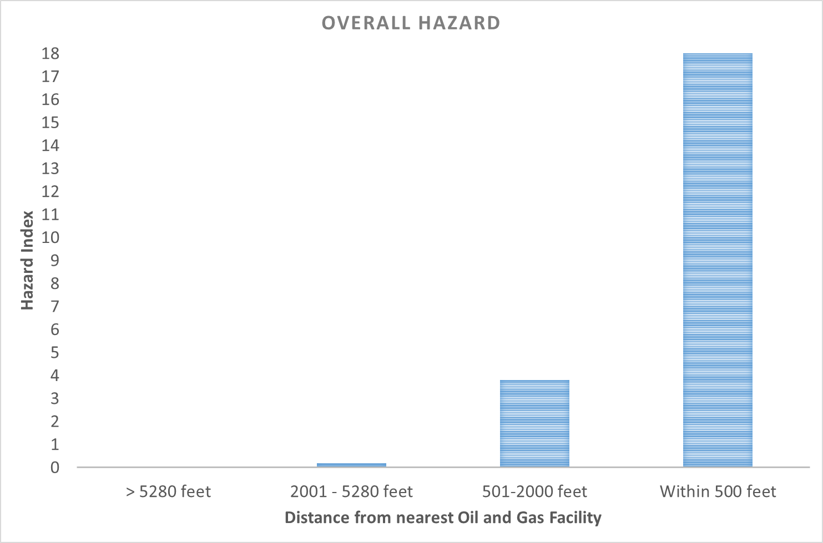
Acute Hazards:
> 1 ➔ Potential for health effects (McKenzie et. al. in review at ES&T)

Slide 6
Preliminary Health Studies
Children with congenital heart defects and leukemia are more likely to live in areas with the highest density of oil and gas wells (McKenzie et. al. 2014, McKenzie et. al. 2017).

Slide 7
Preliminary Health Studies other States
Health conditions more likely as proximity to UNGD wells/activity increases:
Low birth weight (Stacy et. al. 2015)
Preterm birth and high risk pregnancy (Casey et. al. 2015)
Asthma exacerbations (Rasmussen et. al. 2016)
Nasal and sinus, migraine headache, and fatigue symptoms (Tustin et. al. 2016)

Slide 8
Ground level Ozone
O&G Operations along Colorado’s Northern Front Range contribute to about 20% of total ozone production and 30-40% on high ozone days (Edwards et al. 2016).
Ozone levels along Colorado’s Northern Front Range exceed National Ambient Air Quality Standard of 70 ppb over 8 hours.
Each 10 ppb increase in ozone may results in a 2% increase in mortality (Turner et. al. 2016).

Slide 9
Bibliography
Adgate, JL, BD Goldstein, LM McKenzie. 2014. Critical review: Potential public health hazards, exposures and health effects from unconventional natural gas development. In Press: Environ Sci Technol; [Online February 24 2014, DOI: 10.1021/es404621d]
Bunch, A.G., Perry, C.S., Abraham, L. Wikoff, D.S., Tachovsky, J.A., Hixon, J.G., Urban, J.D., Harris, M.A., Haws, L.C. Evaluation of Impact of Shale Gas Operations in the Barnett Shale Region on Volatile Organic Compounds in Air and Potential Human Health Risks. Science of the Total Environment, 468, 832-842, 2014
Casey, J. A.; Savitz, D. A.; Rasmussen, S. G.; Ogburn, E. L.; Pollak, J.; Mercer, D. G.; Schwartz, B. S., Unconventional natural gas development and birth outcomes in Pennsylvania, USA. Epidemiology (Cambridge, Mass.) 2016, 27, (2), 163Colborn, T., Kwiatkowski, C., Schultz, K., Bachran, M. Natural Gas Operations from a Public Health Perspective. Human and Ecological Risk Assessment: An International Journal, 17 (5), 1039-1056, 2011.
Edwards, P.; McDuffie, E. E.; Gilman, J. B.; Lerner, B.; Dubé, W. P.; Trainer, M.; Wolfe, D. E.; deGouw, J.; Williams, E. J.; Tevlin, A. G., Influence of Oil and Gas Emissions on Summertime Ozone in the Colorado Northern Front Range. Journal of Geophysical Research 2016.
Ferrar, K.J., Kriesky, J., Christen, C.L., Marshall, L.P., Malone, S.L., Sharma, R.K., Michanowicz, D.R., Goldstein, B.D. Assessment and Longitudinal Analysis of Health Impacts and Stressors Perceived to Result from Unconventional Shale Gas Development in the Marcellus Shale Region. International Journal of Occupational and Environmental Health, 19 (2) 104-12, 2013.
Finkel, M. Shale gas Development and cancer incidence in southwest Pennsylvania. Public Health, 141: 198-206
Fryzek, J., Pastula, S., Jiang, X., Grabrant, D.H. Childhood Cancer Incidence in Pennsylvania Counties in Relation to Living in Counties with Hydraulic Fracturing Sites. Journal of Occupational and Environmental Medicine, 55 (7), 796-801, 2013.
Halliday, H. S., A. M. Thompson, A. Wisthaler, D. R. Blake, R. S. Hornbrook, T. Mikoviny, M. Müller, P. Eichler, E. C. Apel, and A. J. Hills (2016), Atmospheric benzene observations from oil and gas production in the Denver-Julesburg Basin in July and August 2014, J. Geophys. Res. Atmos., 121, 11,055–11,074, doi:10.1002/2016JD025327
Helmig D, Thompson C, Evans J, Park J-H. Highly Elevated Atmospheric Levels of Volatile Organic Compounds in the Uintah Basin, Utah. Environmental Science & Technology 2014; 48: 4707-4715;
Jemielita, T.; Gerton, G. L.; Neidell, M.; Chillrud, S.; Yan, B.; Stute, M.; Howarth, M.; Saberi, P.; Fausti, N.; Penning, T. M.; Roy, J.; Propert, K. J.; Panettieri, R. A., Jr., Unconventional Gas and Oil Drilling Is Associated with Increased Hospital Utilization Rates. PloS one 2015, 10, (7), e0131093
Kassotis, C.D., Tillitt, D.E., Davis, J.W., Hormann, A.M., Nagel, S.C. Estrogen and Androgen Receptor Activities of Hydraulic Fracturing Chemicals and Surface and Ground Water in a Drilling-Dense Region. Endocrinology, 155 (3) 2014.
McKenzie, LM, W Allshouse, T Byers, E Bedrick, B Serdar, and JL Adgate. 2017. Childhood hematologic cancer and residential proximity to oil and gas development in rural Colorado. PLoS One. 2017 Feb 15;12(2):e0170423. doi: 10.1371/journal.pone.0170423. PMID: 28199334
McKenzie, LM, R Guo, RZ Witter, DA Savitz, LS Newman, and JL Adgate. 2014. Birth outcomes and maternal residential proximity to natural gas development in rural Colorado. In Press, Environ Health Perspect; [Online January 28; DOI 10.1289/ehp.1306722]
McKenzie, L.; Allshouse, W.; Burke, T.; Blair, B.; Adgate, J., Population size, growth, and social vulnerabilities: setbacks between homes and oil and gas wells in Colorado. In Press, ES&T 2016.
McKenzie, L.M., Witter, R.Z., Newman, L.S., Adgate J.L. Human Health Risk Assessment of Air Emissions from Development of Unconventional Natural Gas Resources. Science of the Total Environment , 424, 79-87, 2012.
Rasmussen, S. G.; Ogburn, E. L.; McCormack, M.; et al., ASsociation between unconventional natural gas development in the marcellus shale and asthma exacerbations. JAMA Internal Medicine 2016
Stacy, S.; Brink, L.; Larkin, J.; Sadovsky, Y.; Goldstein, B.; Pitt, B.; Talbott, E., Perinatal Outcomes and Unconventional Natural Gas Operations in Southwest Pennsylvania. PloS one 2015, 10, (6).
Steinzor, N., Subra, W., Sumi, L. Investigating Links between Shale Gas Development and Health Impacts Through a Community Survey Project in Pennsylvania. New Solutions: A Journal of Environmental and Occupational Health Policy, 23 (1) 55-83, 2013.
Turner, M. C.; Jerrett, M.; III, C. A. P.; Krewski, D.; Gapstur, S. M.; Diver, W. R.; Beckerman, B. S.; Marshall, J. D.; Su, J.; Crouse, D. L.; Burnett, R. T., Long-Term Ozone Exposure and Mortality in a Large Prospective Study. American journal of respiratory and critical care medicine 2016, 193, (10), 1134-1142.
Tustin, A. W.; Hirsch, A. G.; Rasmussen, S. G.; Casey, J. A.; Bandeen-Roche, K.; Schwartz, B. S., Associations between Unconventional Natural Gas Development and Nasal and Sinus, Migraine Headache, and Fatigue Symptoms in Pennsylvania. Environ Health Perspect 2016
Witter, R.Z., McKenzie, L.M., Stinson, K.E., Scott, K., Newman, L.S., Adgate, J. The Use of Health Impact Assessment for a Community Undergoing Natural Gas Development. American Journal of Public Health, 103 (6), 1002-10, 2013.

