Slide 1
Local Government
Land Use Tools for Oil and Gas
Matthew Sura
Attorney at Law
(720) 563-1866
mattsura.law@gmail.com

Slide 2
Local Responses to Preemption:
Overview of Tools/Approaches

Slide 3
The Brighton Ordinance
Voluntary Standard – MOU Administrative Review | Mandatory Standards – City Council Hearing
1,000 Setback from Occupied Buildings | Transportation plan
Groundwater monitoring beyond state mandate | Alternative location analysis for sites less than 1,000 feet from home
Required piping of water, best efforts for oil pipelines | Emergency response plan
Noise reduction beyond states standards | Noise mitigation plan

Slide 4
Boulder County’s 2017 regulations
The new 2017 regulations address these (and other) concerns that were not adequately covered under the 2012 regulations:
Industry’s shift toward large-scale, consolidated facilities
Concerns with intensity of oil and gas development
Additional information about impacts
Rulemaking at the State level (Governor’s Task Force, etc.)
Concerns with impacts on community and environment

Slide 5
Boulder County’s 2017 regulations
Special Use Review for all new oil and gas development in unincorporated Boulder County.
Comprehensive – They ask for detailed information and plans from operators in order to fully evaluate impacts and assess site-specific circumstances related to each oil and gas development application. They ask for alternative site locations.
Inclusive – The regulations require extensive notice to surrounding landowners, provide multiple opportunities for public input, including a neighborhood meeting and public hearings in front of the Planning Commission and Board of County Commissioners.
Protective – The regulations will closely scrutinize all proposed oil and gas development and hold operators to a high standard. The county will use 17 criteria to evaluate potential impacts on the surrounding area and the environment.
Specific – The regulations provide details on conditions of approval and mitigation measures that the county may impose to reduce the impacts on neighboring landowners and preserve the county land and environment.
Enforceable – all approved oil and gas development will be subject close monitoring and operators will be required to comply with all requirements and mitigation measures.

Slide 6
Boulder County’s 2017 regulations
Some of the more defining components new regulations include options for:
Air quality monitoring
Hydrocarbon emissions control measures, including use of infra-red cameras to detect and repair leaks of equipment used on the well site
Water well sampling and testing
Conditions of approval that will reduce impacts to the site/area/resources, including change in location, use of pipelines to reduce truck traffic, reduction of the number of wells, adjustment of pad dimensions, use of shared infrastructure, visual buffering/landscaping, etc.

Slide 7
Boulder County’s 2017 regulations
Some of the more defining components new regulations include options for:
Disruption payments to surrounding occupants of residential structures who are affected by drilling activities – an operator would be required to pay the cost to rent a replacement home for the number of months construction and drilling take place, plus the cost to move away and back
Emergency preparedness and response plan
Reporting, monitoring, and inspections

Slide 8
Broomfield Operator Agreement
Limitation on number of wells (84 new wells)
P&A more than 40 wells
Comprehensive Drilling Plan submitted with Form 2A (24 plans and exhibits)
Quiet fleet fracking technology
Use oil pipelines
Right to inspect (upon reasonable notice)
Prohibit use of problematic chemicals
All drilling and production equipment will be electric

Slide 9
Broomfield Operator Agreement
Natural gas fracking equipment
Best management practices for protection of air quality
$20,000 / year for annual air quality sampling
Water quality sampling – Baseline samples of ALL water sources within ½ mile!
Residential noise levels under Rule 802 during drilling and fracking - (high of 55 d(b) rather than 80d(b)) as measured 1,000 feet from sound walls.

Slide 10
Broomfield Operator Agreement
Soil testing at plugged and abandoned locations prior to and following drilling and completion
Alternative site analysis
Report of any fires or explosions
Surface Safety Valve that can be operated remotely
Pipeline integrity standards

Slide 11
Negotiating MOUs

Slide 12
Negotiating MOUs
  Entry point – what started process?
  Parties involved in discussion
  Role and authority of council board and staff
  Application of MOU to entire jurisdiction or certain well site locations?
  Leverage
  Communications and relationships in/due to negotiation process – Is trust being built or lost?
  Public participation and due process considerations or concerns
  Lessons learned.

Slide 13
Location, Location, Location

Slide 14
Informal discussions of location
Early notification of operator’s plans
    COGCC Rule 302.c – Registration and notice of five-year plans
    COGCC spacing applications
    Pre-application meetings
    Code requirements -- directing location choices
    Surface use agreements

Slide 15
COGCC Rule 302.c – Registration and notice of five-year plans
(3) A municipal local jurisdiction may request…
…a good faith estimate of the number of wells the operator intends to drill in the next five years in the local jurisdiction. A publicly traded company’s well estimates may be based on reserves classified as “proved undeveloped” for SEC reporting purposes.
A map showing [existing and planned well sites]
…Well estimates are subject to change at any time at the operator’s sole discretion.

Slide 16
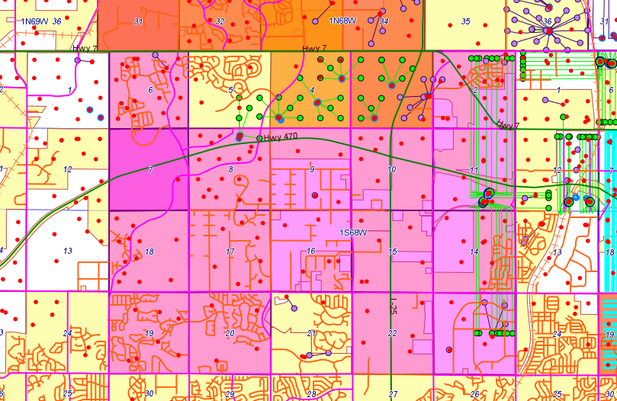
COGCC spacing applications

Slide 17
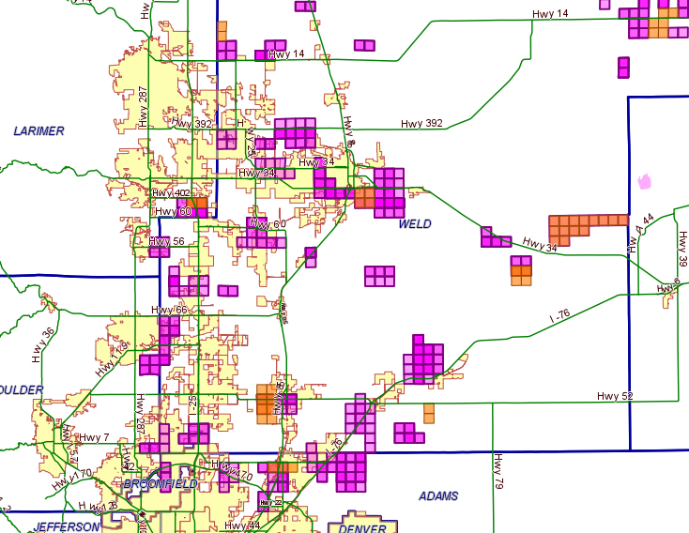
Greeley
Windsor
Berthoud
Longmont
Keenesburg
Lochbuie
Erie
Dacono
Brighton
Thornton

Slide 18
Informal discussions of location
Early notification of operator’s plans
    Pre-application meetings
    Code requirements -- directing location choices
    Surface use agreements

Slide 19
COGCC Setbacks- 600 series Rules
Schools and hospitals: 1,000-foot setback unless operator requests a hearing
Urban Setbacks: 500-foot setback
Affects less than 4% of wells
Rural Setback: 500-foot setback
Allows an “exception” if the industry asks for it
The only requirement is that impacts are mitigated to the greatest extent economically practicable
Outdoor Activity Area: 350-foot setback

Slide 20
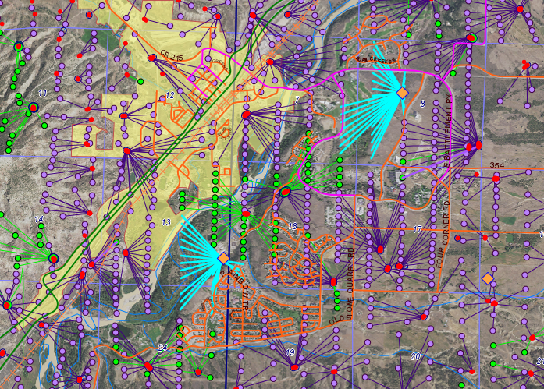

Slide 21
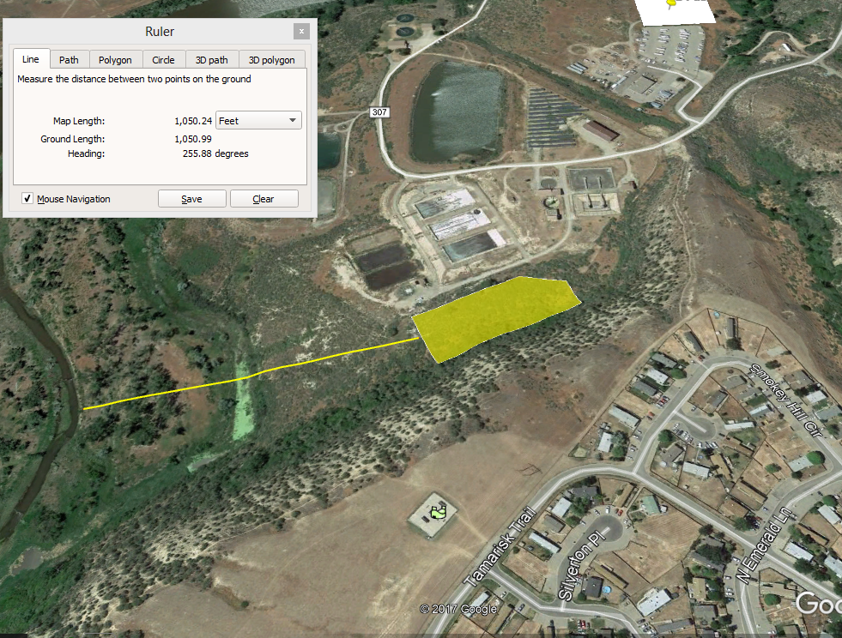
Google Map showing that a channel of the Colorado River is just over 1,000 feet from the proposed Pad A rather than over 2,000 feet as claimed by Ursa.

Slide 22
Local Government Siting Tools
    Zoning
          Longmont, Commerce City
    Local government setbacks
          Longmont, Thornton
    MOUs
  Adams Co., Arapahoe Co., Brighton, Broomfield Co., Elbert Co., Erie, Ft. Collins, Hudson, LaPlata Co., Longmont, Timnath
    Alternative location analysis – Rule 604
          Broomfield, Boulder County, Brighton

Slide 23
COGCC Rule 604c.(2)E
Any “multi-well production facility” that is proposed near a residential area must prove it is located “as far as possible” from homes.

Slide 24
COGCC Rule 604c.(2)E
(Pursuant to Rule 604.c.(2)E.i., the operator must evaluate alternative locations for the Production Facilities that are farther from the Building Unit, and determine whether those alternative locations were technically feasible and economically practicable for the same proposed development.)

Slide 25
COGCC Rule 604c.(2)E
19) If a well or production facility is proposed to be located less than 1,000 feet from a High Occupancy Building Unit, a Building Unit, or public water supply well(s), the Applicant shall submit the following “alternative location analysis” as part of the Application:
On a map, denote all practicable and economically feasible surface locations that are a greater distance from Building Units and public water supply wells than the location proposed.
A brief explanation of why each alternative location was not chosen.

Slide 26
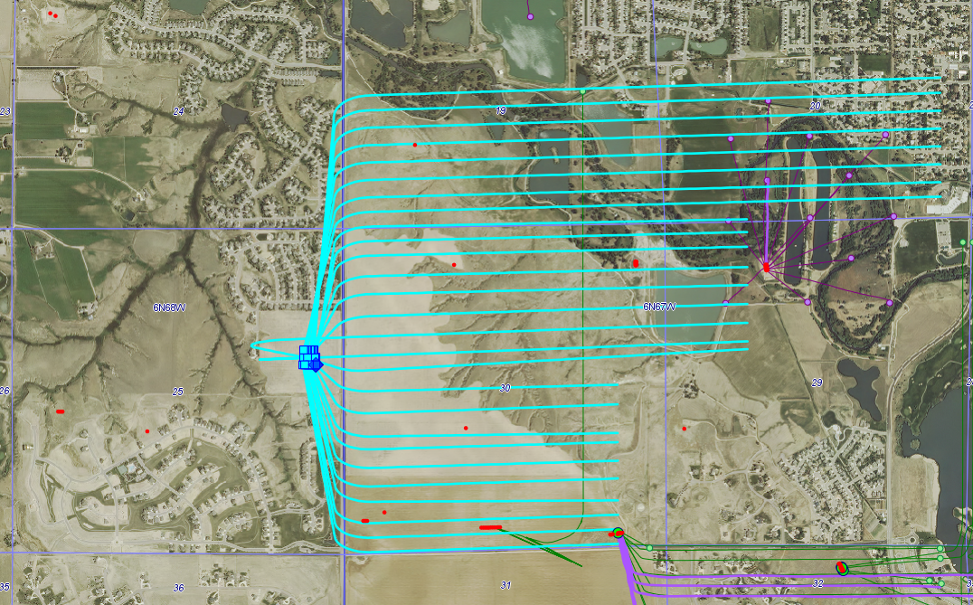
Great Western proposal in Windsor

Slide 27
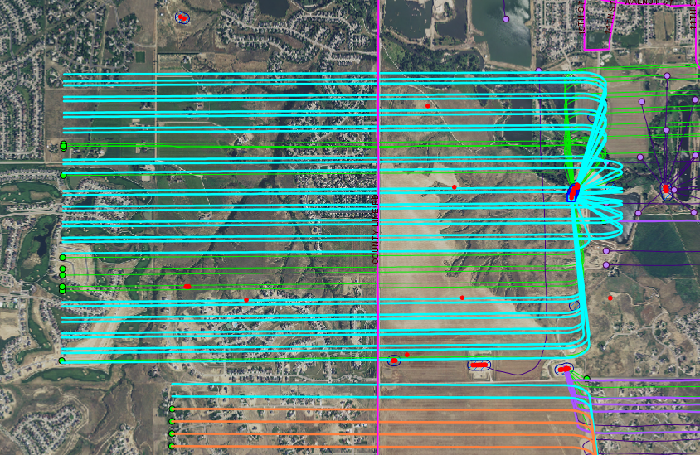

Slide 28
Setback of homes from
oil and gas development?

Slide 29
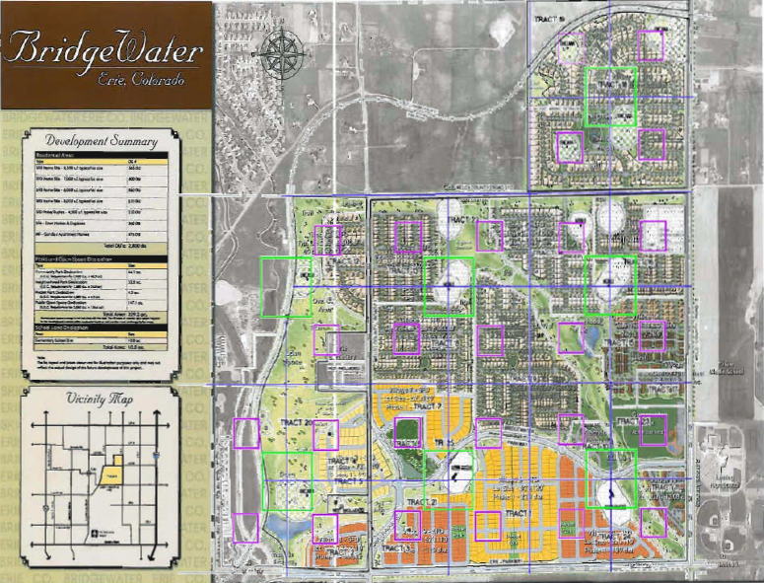

Slide 30
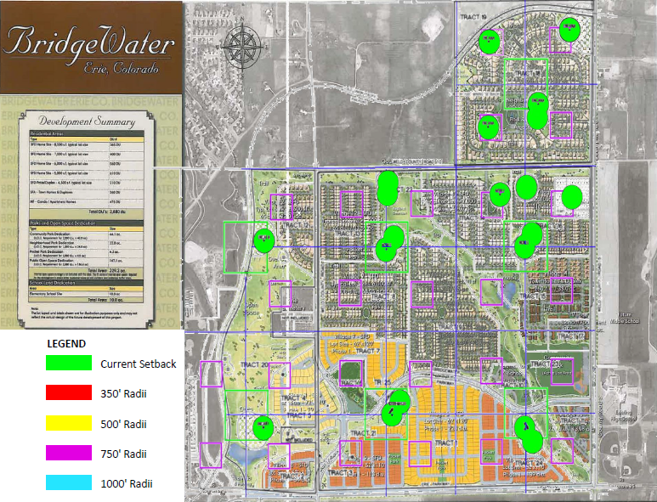

Slide 31
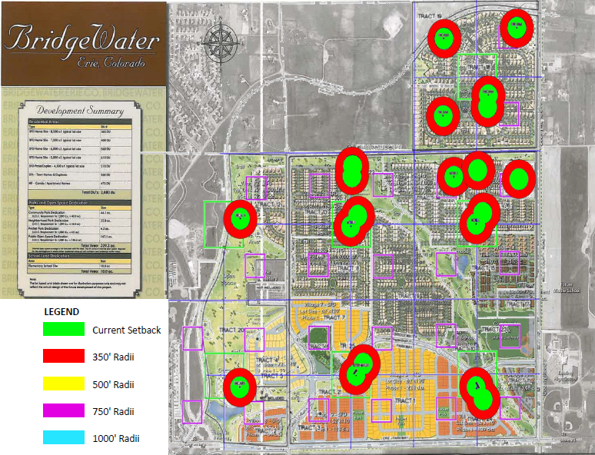

Slide 32
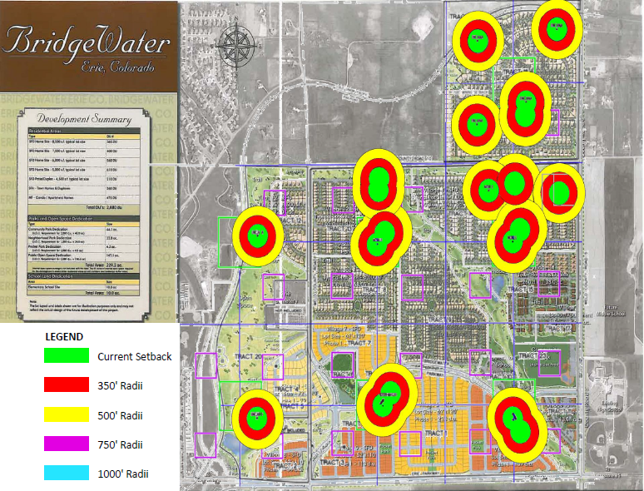

Slide 33
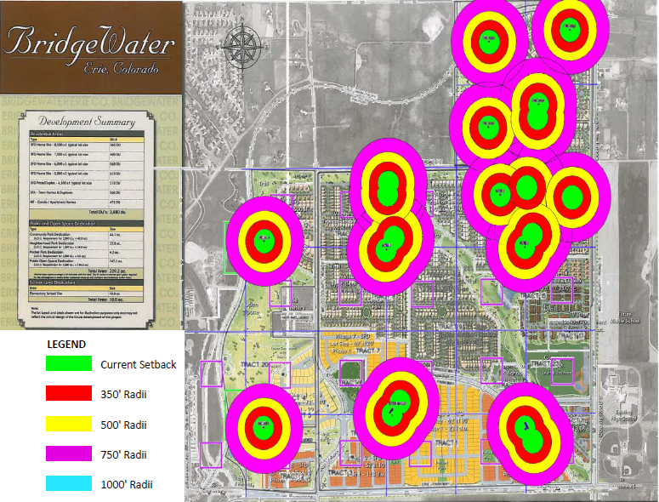

Slide 34
