Slide 1

Best Management Practices for Oil and Gas Development & Comparative Water Quality Database of Regulations relating to Shale Oil and Gas
American Society of Law, Medicine & Ethics
Network for Public Health Law
Public Health Law Research Program
The legal information and assistance provided in this webinar does not constitute legal advice or legal representation, nor reflect the opinion of the series partners.

Slide 2
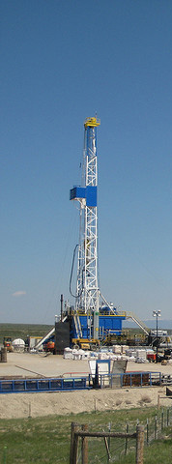


Best Management Practices
for Oil and Gas Development &
Comparative Water Quality Database of Regulations relating to Shale Oil and Gas
Public Health Law Webinar series
March 20, 2014
Matt Samelson
Getches-Wilkinson Center for Natural Resources, Energy and the Environment, University of Colorado Law School

Slide 3

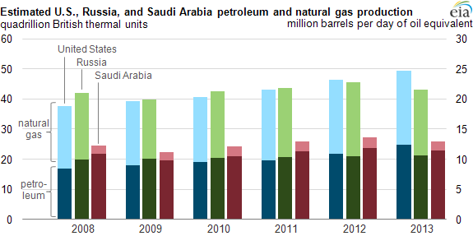
Context
Estimate U.S., Russia, and Saudi Arabia Petroleum and Natural Gas Production
Notes:
October 4, 2013
The U.S. Energy Information Administration estimates that the United States will be the world's top producer of petroleum and natural gas hydrocarbons in 2013, surpassing Russia and Saudi Arabia. For the United States and Russia, total petroleum and natural gas hydrocarbon production, in energy content terms, is almost evenly split between petroleum and natural gas. Saudi Arabia's production, on the other hand, heavily favors petroleum.

Slide 4
Context
“For years, environmentalists and the gas drilling industry have been in a pitched battle over the possible health implications of hydro fracking. But to a great extent, the debate — as well as the emerging lawsuits and the various proposed regulations in numerous states — has been hampered by a shortage of science.”
Drilling for Certainty: The Latest in Fracking Health Studies. ProPublica, March 5, 2014
Notes:
In 2011, when ProPublica first reported on the different health problems afflicting people living near gas drilling operations, only a handful of health studies had been published. Three years later, the science is far from settled, but there is a growing body of research to consider.
Below, ProPublica offers a survey of some of that work. The studies included are by no means a comprehensive review of the scientific literature. There are several others that characterize the chemicals in fracking fluids, air emissions and waste discharges. Some present results of community level surveys.
Yet, a long-term systematic study of the adverse effects of gas drilling on communities has yet to be undertaken. Researchers have pointed to the scarcity of funding available for large-scale studies as a major obstacle in tackling the issue.
A review of health-related studies published last month in Environmental Science & Technology concluded that the current scientific literature puts forward “both substantial concerns and major uncertainties to address.”
Still, for some, waiting for additional science to clarify those uncertainties before adopting more serious safeguards is misguided and dangerous. As a result, a number of researchers and local activists have been pushing for more aggressive oversight immediately.
The industry, by and large, has regarded the studies done to date — a number of which claim to have found higher rates of illness among residents living close to drilling wells — as largely anecdotal and less than convincing.
“The public health sector has been absent from this debate,” said Nadia Steinzor, a researcher on the Oil and Gas Accountability Project at the environmental nonprofit, Earthworks.

Slide 5
Context
“Despite broad public concern, no comprehensive population-based studies of the public health effects of unconventional natural gas operations exist.”
“Potential Public Health Hazards, Exposures and Health Effects from Unconventional Natural Gas Development”
Environmental Science & Technology, Feb. 24, 2014
John L. Adgate, Bernard D. Goldstein, and Lisa M. McKenzie
Notes:
Potential Public Health Hazards, Exposures and Health Effects from Unconventional Natural Gas Development
Environmental Science and Technology journal
Feb. 24, 2014
John L. Adgate, Bernard D. Goldstein, and Lisa M. McKenzie
The rapid increase in unconventional natural gas development in the United States during the past decade has brought wells and related infrastructure closer to population centers. This review evaluates risks to public health from chemical and nonchemical stressors associated with unconventional natural gas, describes likely exposure pathways and potential health effects, and identifies major uncertainties to address with future research. The most important occupational stressors include mortality, exposure to hazardous materials and increased risk of industrial accidents. For communities near development and production sites the major stressors are air pollutants, ground and surface water contamination, truck traffic and noise pollution, accidents and malfunctions, and psychosocial stress associated with community change. Despite broad public concern, no comprehensive population-based studies of the public health effects of unconventional natural gas operations exist. Major uncertainties are the unknown frequency and duration of human exposure, future extent of development, potential emission control and mitigation strategies, and a paucity of baseline data to enable substantive before and after comparisons for affected populations and environmental media. Overall, the current literature suggests that research needs to address these uncertainties before we can reasonably quantify the likelihood of occurrence or magnitude of adverse health effects associated with UNG production in workers and communities.
John and Lisa are from the University of Colorado School of Public Health
Bernard is with the Graduate School of Public Health at the University of Pittsburgh

Slide 6
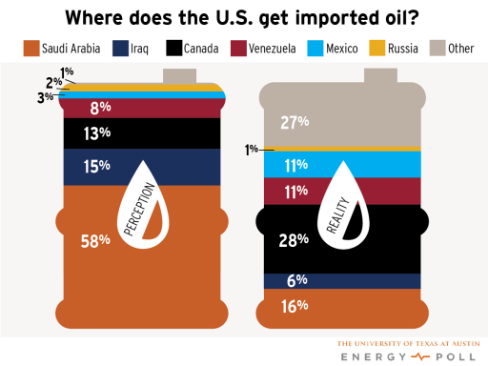
Public Perception
Notes:
The University of Texas at Austin’s Energy Poll group conducts energy surveys twice a year. The survey of consumer perspectives on energy, conducted Sept. 5–23, 2013, shows mixed views on the recent surge in domestic natural gas production, largely made possible by the widespread use of hydraulic fracturing in tandem with horizontal drilling. Among the 40 percent of Americans who say they are familiar with the technology, only 38 percent support hydraulic fracturing, down from 45 percent six months ago.
Americans fare poorly when it comes to general energy literacy. Fifty-eight percent think that the nation’s largest foreign supplier of oil is Saudi Arabia, while just 13 percent chose the correct answer, Canada. Thirty-one percent say they are knowledgeable about how energy is produced, delivered and used, but less than half (46 percent) of this group correctly chose Canada as our largest foreign supplier of oil. Responses also varied widely by gender, with 44 percent of men and 20 percent of women describing themselves as knowledgeable about energy.

Slide 7
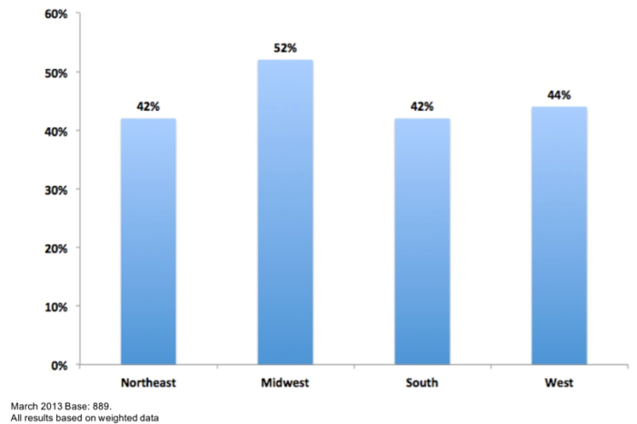
Public Perception
Support for the use of hydraulic fracturing by region
Data represents survey respondents who say they are familiar with the term hydraulic fracturing (42% of total base or 889 out of 2117 individuals).
March 2013
Source: University of Texas at Austin Energy Poll
Notes:
2117 Respondents
The survey of consumer perspectives on energy, conducted Sept. 5–23, 2013, shows mixed views on the recent surge in domestic natural gas production, largely made possible by the widespread use of hydraulic fracturing in tandem with horizontal drilling. Among the 40 percent of Americans who say they are familiar with the technology, only 38 percent support hydraulic fracturing, down from 45 percent six months ago.

Slide 8
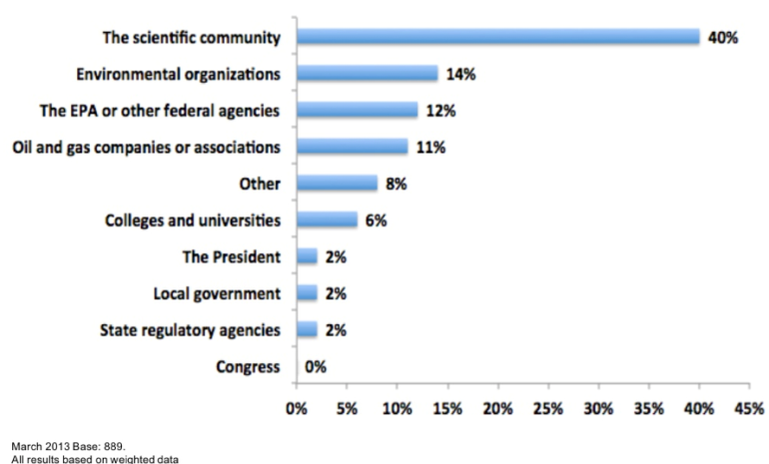
Public Perception
Who do you trust most to provide accurate, impartial information on hydraulic fracturing?
Source: University of Texas at Austin Energy Poll
Notes:
According to the Energy Poll, people are looking to the scientific community to provide impartial information about hydraulic fracturing.
The middle peddle on the floorboard of your car, or at least the cars, I grew up with, is the brake pedal. You have communities that are either unaccustomed to oil and gas production or maybe they’re accustomed to it, but not the current pace, looking to tap the brakes. Communities above the Marcellus in the Northeast, the Niobrara along Colorado’s Front Range, and the Barnett with Dallas and Fort Worth.
But if you look at the indicators such as oil and gas production levels, applications for permits to drill, and numbers of drill rigs, at the risk of prolonging a metaphor, the industry is punching the gas pedal.
So there’s a tension out there.

Slide 9
Resources
Intermountain Oil & Gas Best Management Practices project
  http://www.oilandgasbmps.org
LawAtlas Water Quality Database
  http://lawatlas.org/oilandgas

Slide 10
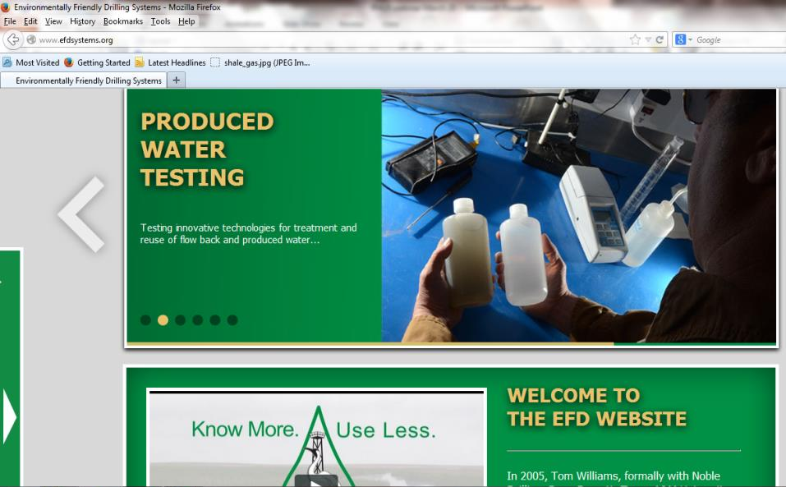
Environmentally Friendly Drilling Systems

Slide 11

BMP Definitions
Bureau of Land Management / BMP Project
  State-of-the-art mitigation measures applied to oil and natural gas drilling and production to help ensure that energy development is conducted in an environmentally responsible manner.
http://www.blm.gov/wo/st/en/prog/energy/oil_and_gas/
best_management_practices.html
ble manner.”
Notes:
Source: definition from BLM website. http://www.blm.gov/wo/st/en/prog/energy/oil_and_gas/best_management_practices.html

Slide 12
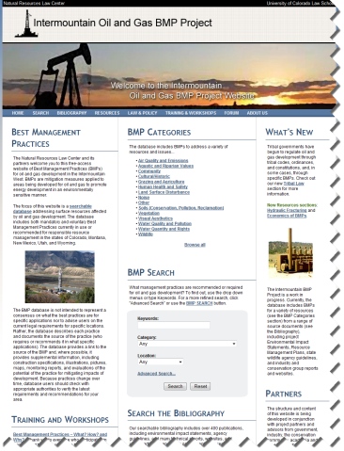
Best Management Practices for Oil and Gas Development
Intermountain Oil and Gas BMP Project – www.oilandgasbmps.org
Project Objectives
Create a free, online database documenting BMPs for responsible oil and gas development in the Intermountain West
Provide BMPs and other resource information to a wide audience, including industry, community, government, and environmental advocates
Notes:
The focus of this website is a searchable database addressing surface resources affected by oil and gas development. The database includes both mandatory and voluntary Best Management Practices currently in use or recommended for responsible resource management in the states of Colorado, Montana, New Mexico, Utah, and Wyoming.
The BMP database includes the following categories: air quality and emissions, aquatic and riparian values, community, cultural/historic, grazing & agriculture, human health & safety, land surface disturbance, noise, soils (conservation, pollutions, reclamation), vegetation, visual aesthetics, water quality and pollution, water quantity and rights, and wildlife.

Slide 13
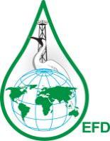
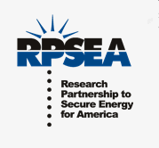

Intermountain Oil & Gas BMP Project
Geographic Scope
  CO, MT, NM, UT, WY
  Beyond the Region
Website Background Materials
  Resource Pages
  Law and Policy
  (Federal, state, local, tribes)
Database and Bibliography
  Voluntary practices
  Required practices
Research Services
Workshops
Project Components

Slide 14
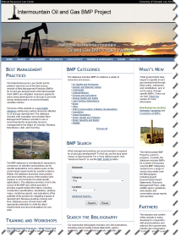

Intermountain Oil & Gas BMP Project
Project Results
The database contains 8,500 BMPs, from nearly 500 source documents in categories such as Wildlife, Water, Air, Health, Soils, and Vegetation.
Resource and Law & Policy sections provide additional information, such as Hydraulic Fracturing, Economics of BMPs, Reclamation, and laws and policies governing oil and gas development in the Intermountain West
Notes:
The BMP database includes the following categories: air quality and emissions, aquatic and riparian values, community, cultural/historic, grazing & agriculture, human health & safety, land surface disturbance, noise, soils (conservation, pollutions, reclamation), vegetation, visual aesthetics, water quality and pollution, water quantity and rights, and wildlife.

Slide 15
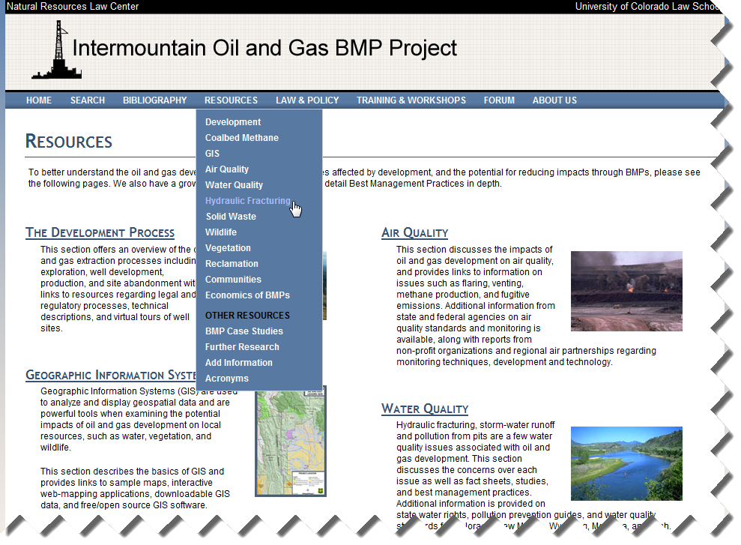

Slide 16
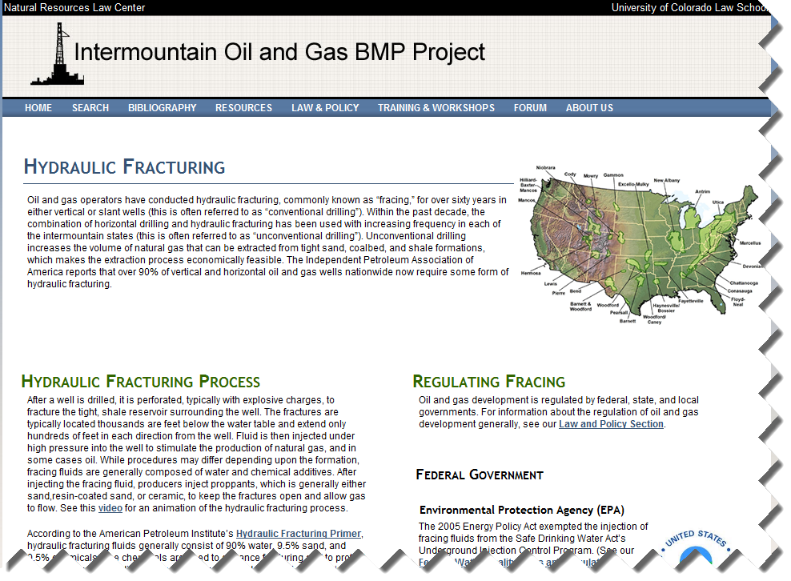

Slide 17
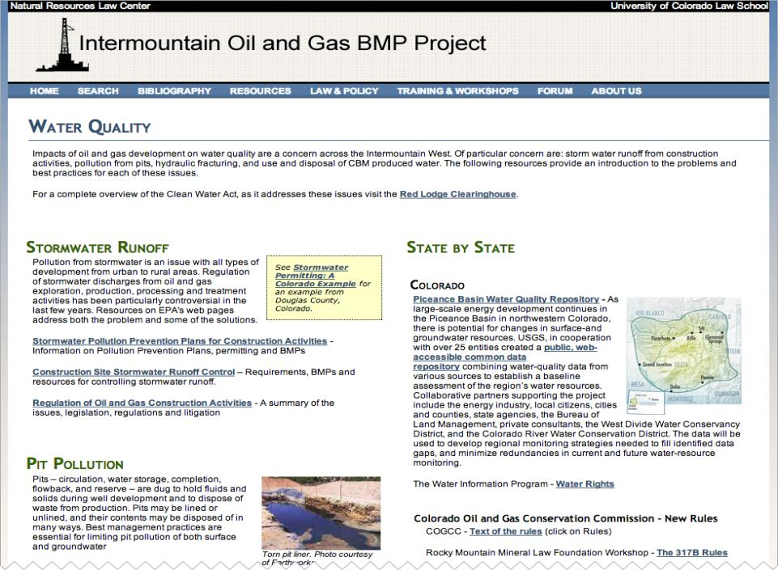
Notes:
Links to Hydraulic fracturing page
info on CBM

Slide 18


Technology Integration Program: Objective
Project Objective
Produce and make publicly available, a searchable database of laws and regulations pertaining to shale oil and shale gas.
  Water Quality (completed)
  Water Quantity (June 2014)
  Air Quality (Fall 2014)
Notes:
Public Health Law Research – Temple University – Robert Woods Johnson Foundation

Slide 19
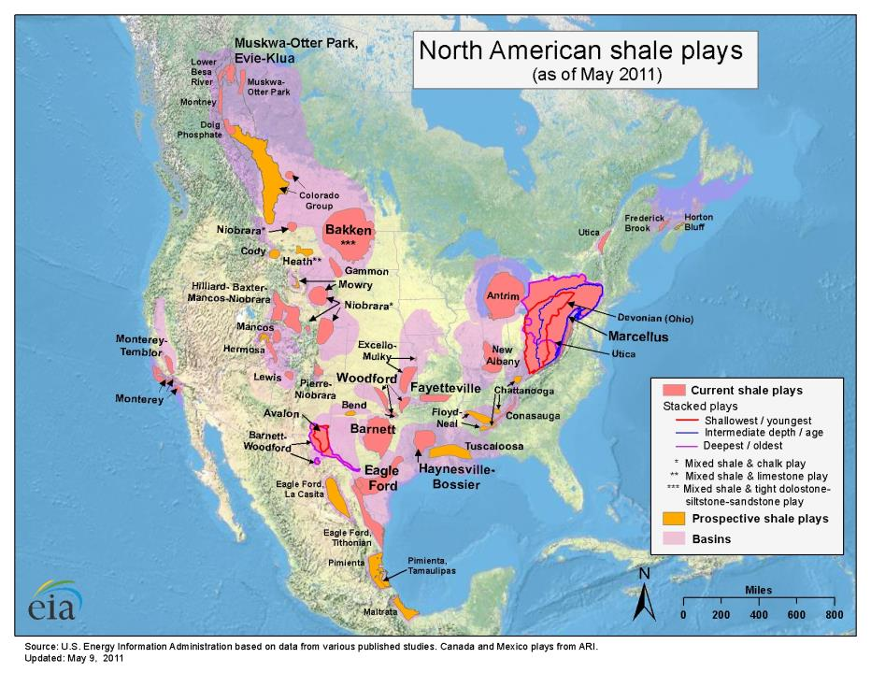

Slide 20
Technology Integration Program: Objective
Project Results (ongoing)
Comparative water quality database
  www.lawatlas.org/oilandgas
  Contains more than 1100 legal citations in five categories:
    Permitting, Design, & Construction
    Well Drilling
    Well Completion
    Production & Operation
    Reclamation

Slide 21
Water Quality – LawAtlas Database
    Texas – Eagle Ford, Barnett
    New York – Marcellus
    Pennsylvania – Marcellus
    Ohio – Marcellus
    West Virginia – Marcellus
    Colorado – Piceance, Niobrara
    North Dakota – Bakken
    Montana – Bakken
    New Mexico – San Juan, Permian
    Wyoming – Greater Green River, Powder River Basin
    Utah – Mancos, Uinta
Current
Next
  Water Quantity (June 2014)
  Air Quality (September 2014)
Notes:
Improved technology developments in directional drilling and hydraulic fracturing have resulted in a boom of oil and gas production nationwide. In fact, in October 2013, the U.S. Energy Information Administration announced that the United States would surpass Russia and Saudi Arabia as the world’s largest producer of oil and natural gas by the end of the year. The boom has resulted in oil and gas development in regions unaccustomed to the industry as well as in regions that have a century-long relationship with oil and gas extraction. However, directional drilling and hydraulic fracturing technologies pose potential water quality risks in regions where oil and gas activities are occurring through wastewater discharges, hydraulic fracturing fluid spills, improper casing/cementing, and other accidental spills. Rapid development of oil and gas wells, particularly in urban and suburban areas, coupled with the practice of hydraulic fracturing has sparked concern for water quality and an interest in laws designed to protect water quality.
We envision the water quality page as a resource that policymakers, local governments, regulated entities, and concerned citizens can use to inform themselves about the scope of laws and regulations of water quality issues arising from both conventional and unconventional oil and gas development.

Slide 22
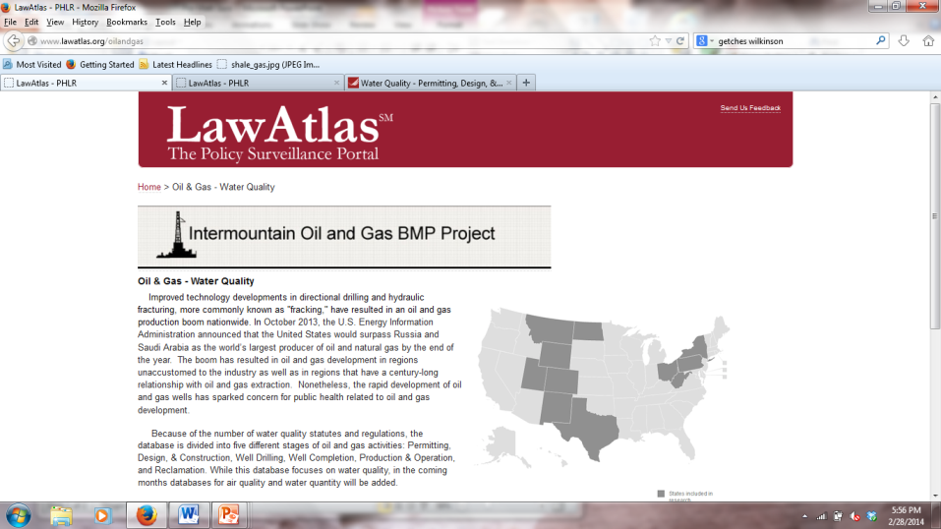
LawAtlas Database
Notes:
Roll out Dec. 2-6.
Water Quality - Permitting, Design, & Construction
Water Quality - Well Drilling
Water Quality - Well Completion
Water Quality - Production & Operation
Water Quality - Reclamation

Slide 23
Hydraulic Fracturing Elections 2013
Fort Collins – Passed a 5-year moratorium on hydraulic fracturing
Boulder – Approved a 5-year moratorium on hydraulic fracturing
Lafayette – Banned new oil and gas drilling within the city limits
Broomfield – Approved a 5-year moratorium on hydraulic fracturing. 20 votes.
Longmont: Banned hydraulic fracturing. (November 2012) Lawsuit filed by Colorado Oil and Gas Association and joined by State.
Notes:
State Statute: Recount automatic when difference is 0.5%.
COGA spent roughly $900,000 opposing these initiatives. Proponents maybe $5,000.
There will be an initiative to ban hydraulic fracturing in Colorado. Quite possibly on the 2014 ballot.

Slide 24

Natural Gas Research and Resources at CU Boulder
For more information
  Browse the websites at www.oilandgasbmps.org and www.lawatlas.org/oilandgas
  Contact Matt Samelson
  matthewsamelson@gmail.com
  303-519-5769
  for questions related to the comparative database.
  Contact Kathryn Mutz
  Kathryn.Mutz@colorado.edu
  303-492-1293
  for questions related to the BMP project.

Slide 25
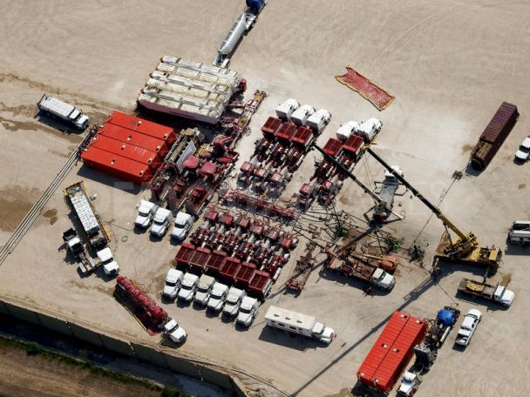
Hydraulic Fracturing

Slide 26
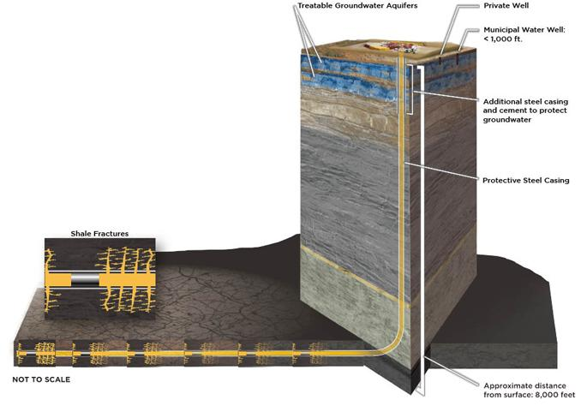
Example Horizontal Well

Slide 27
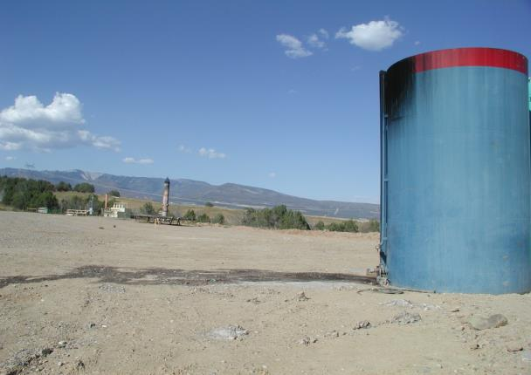
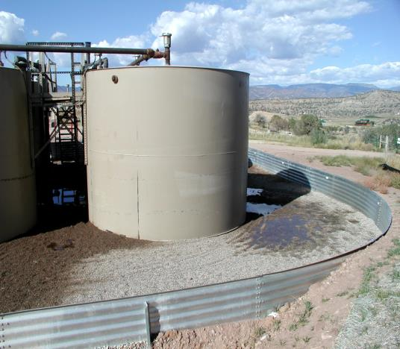
SPILLS
Denver Post study:
From 2008-2010, average of more than a spill per day, average size of 5,300 gallons

Slide 28
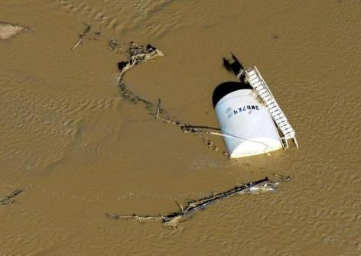
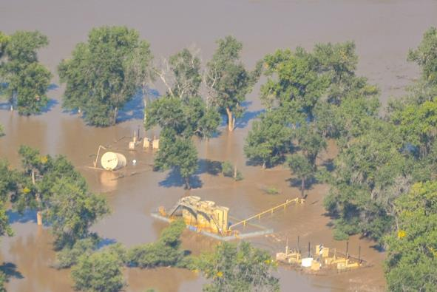
Notes:
In this Sept. 17, 2013 photo, a crude oil storage tank lies on its side in flood water along the South Platte River, in Weld County, Colo. Hundreds of natural gas and oil wells along with pipelines are shut down by flooding, as state and federal inspectors gauge the damage and look for potential contamination from inundated oil fields. (AP Photo/John Wark)
Above: Flooded wells in Weld County, Colorado. Photo courtesy of Jane Pargiter, EcoFlight

Slide 29
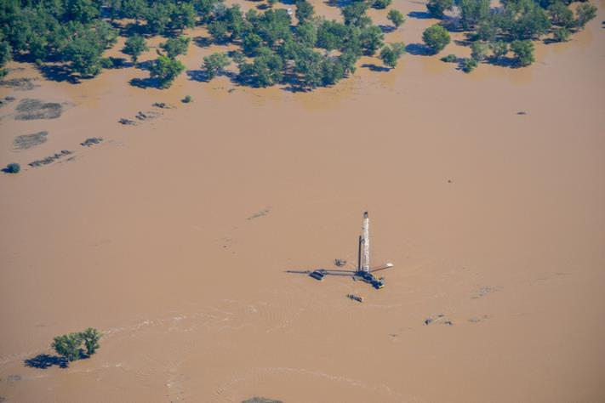

Slide 30

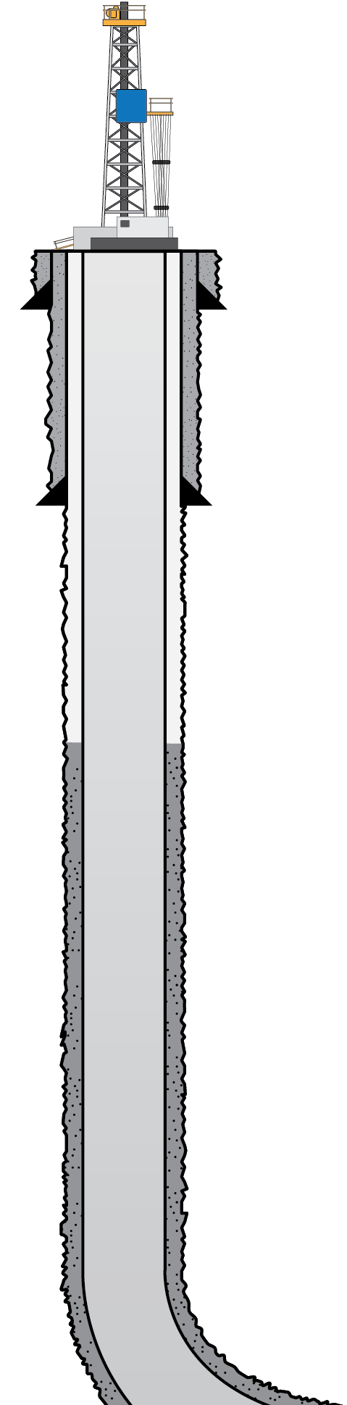
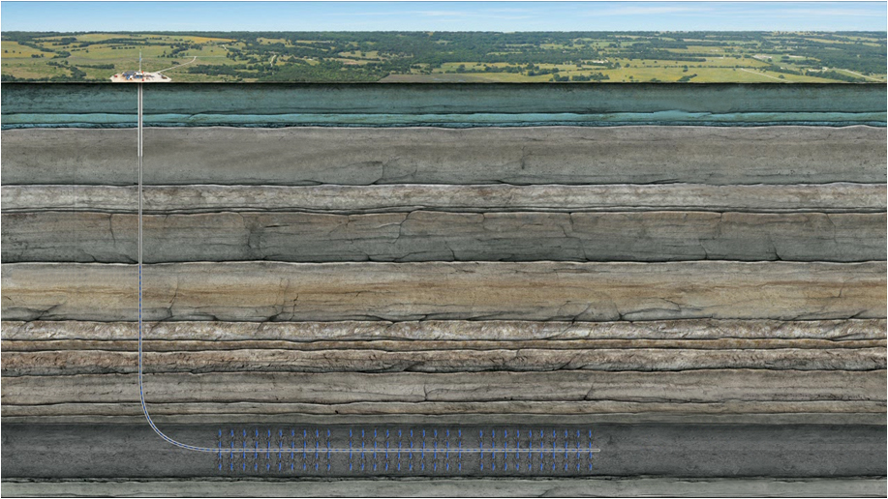


WELL CONSTRUCTION STANDARDS
CONDUCTOR PIPE
CEMENT
FRESH WATER AQUIFER ZONE
SURFACE CASING
CEMENT
400’ Usable Fresh Water
PRODUCTION CASING
Surface Casing 550’
2100’ Various Atoka
Sands & Shales
4000’
of Sediment
SHALLOW PRODUCING ZONE
1300’ Upper Hale
CEMENT
600’ Morrow Shale
300’ Fayetteville Shale
Hindsville
Cross sectional view
TARGET PRODUCING ZONE

Slide 31
GOOD MECHANICAL INTEGRITY
CONDUCTOR PIPE
FRESH WATER AQUIFER ZONE
SURFACE CASING
PRODUCTION CASING
SHALLOW PRODUCING ZONE
TARGET PRODUCING ZONE

Slide 32


CEMENT CHANNELING
CONDUCTOR PIPE
PRESSURE
BUILDS UP
FRESH WATER AQUIFER ZONE
SURFACE CASING
PRODUCTION CASING
FORMATION
SHALLOW PRODUCING ZONE
CASING
CEMENT
TARGET PRODUCING ZONE

Slide 33

INSUFFICIENT CEMENT COVERAGE
CONDUCTOR PIPE
PRESSURE
BUILDS UP
FRESH WATER AQUIFER ZONE
SURFACE CASING
PRODUCTION CASING
SHALLOW PRODUCING ZONE
TARGET PRODUCING ZONE

Slide 34
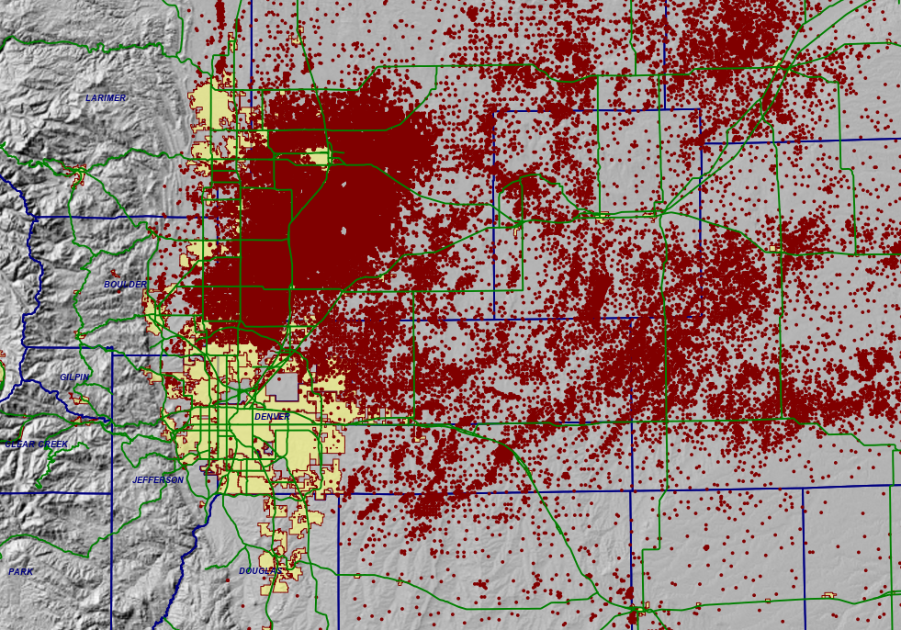

Slide 35
Since January 1, 2013 oil and gas companies reported 495 spills
210 Spills occurred within 1,000 feet of surface water
136 Spills occurred within 500 feet of surface water
151 Spills occurred less than 50 feet from groundwater
41 Spills occurred between 50 and 100 feet from groundwater
Notes:
The Toxic Release Tracker is a summary of the Colorado Oil and Gas Commission’s (COGCC) spill database.

Slide 36
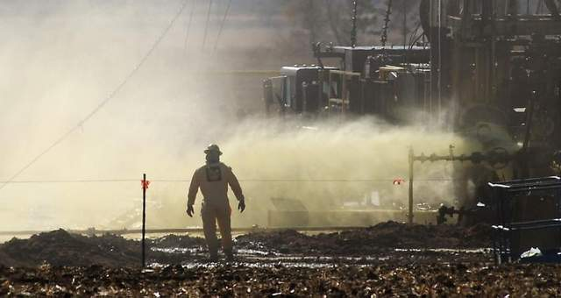
A worker watches oil-laden 'flowback' water spew from the bottom of an oil rig north of Windsor on Feb. 12. / V. Richard Haro/Coloradoan (Fort Collins, Colorado)
Notes:
The 30-hour oil well leak on Feb. 11-12 east of Fort Collins was a “blowout” directly related to fracking, state documents show.
The Colorado Oil and Gas Conservation Commission this week released inspector reports from the incident at PDC Energy’s Ochsner 50-441 well, which remains under investigation.
The well head was damaged by falling equipment Feb. 11, causing oil-laden fracking flowback water to spew from the well at a rate of 20 barrels per hour.
“Formation was over-pressured as the well was in a blownout condition from a previous frac,” the COGCC’s Feb. 11 inspection report says.
By an inspector’s Feb. 14 visit to the site, the spill north of Windsor, which totaled 2,350 barrels, had mostly been cleaned.

